Slide 1
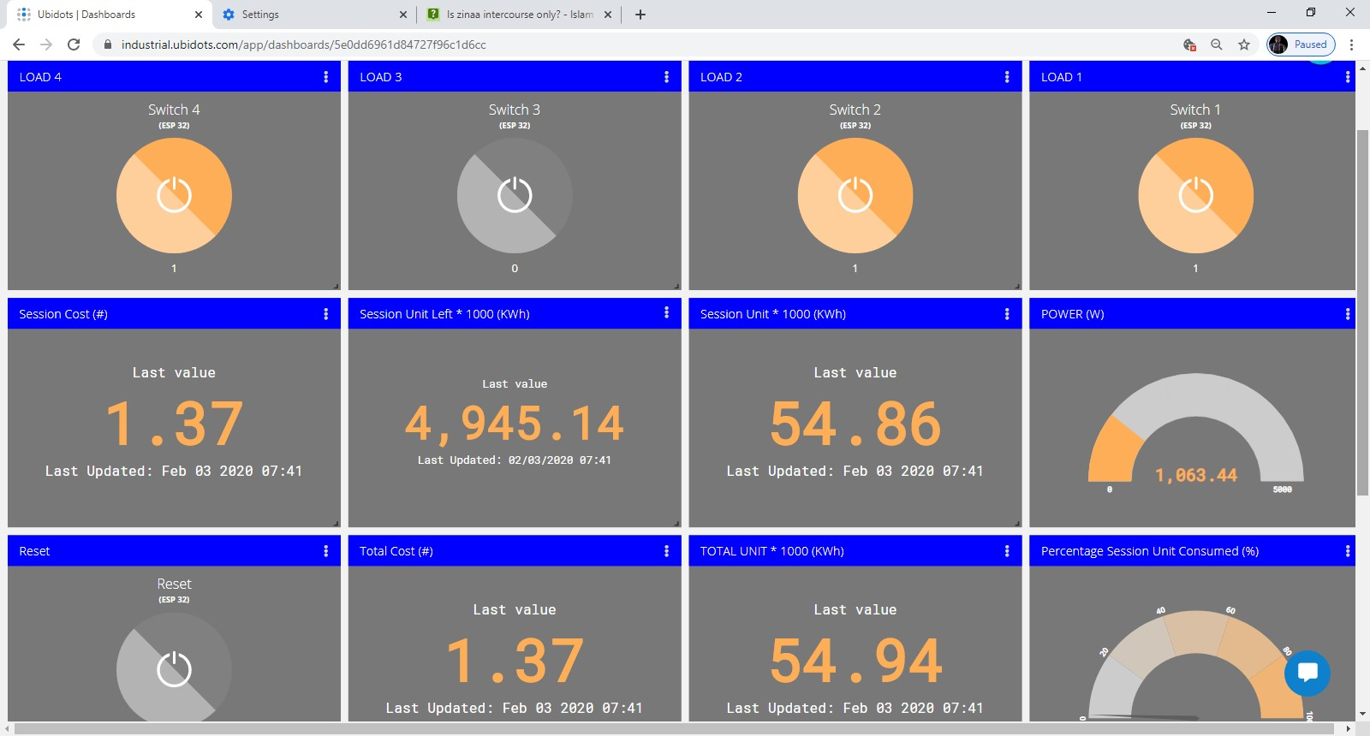
IoT Smart Energy Meter with Load Control
By:
OLADIPO Abdullah Akinwumi
EEG / 2014 / 083
Supervised by:
Dr. (Mrs.) Offiong

Slide 2
Outline
Introduction
Justification
Aim and Objectives
Approach
Parameters being monitored
Illustrative diagrams
Tools
Present state of design
Future work
Summary

Slide 3
Introduction
IoT is the extension of Internet connectivity into physical devices and everyday objects
A smart device is an electronic device, generally connected to other devices or networks via different wireless protocols such as Bluetooth, ZigBee, NFC, Wi-Fi, Li-Fi, 3G, etc., that can operate to some extent interactively and autonomously.
Load control is simply enabling user to have easy and interactive access to domestic loads
IoT Smart Energy Meter is an energy meter connected to the internet which can interact with loads and pushes/pull data from the cloud.

Slide 4
Justification
Present Energy Meter System provides:
Meter reading and display for consumer and meter readers
Most common automation systems only incorporate Bluetooth and IEEE 802.11 comm.
Virtually none incorporates load control
This design ensures:
IoT enabled
Interactive UI (user interface)
Load control

Slide 5
Approach
The area of concentration is energy monitoring and load control
(scope? Yeah!)
Design of the device based on SCT-013-000 sensor to monitor current drain from the supply, ESP32 microcontroller to compute power, energy and bill amount, then communicates the data. Web app as dashboard for controlling and monitoring.
The design is basically grouped into two sections:
Hardware (Circuit and loads)
Software part (Website design, MQTT, Ubidots)

Slide 6
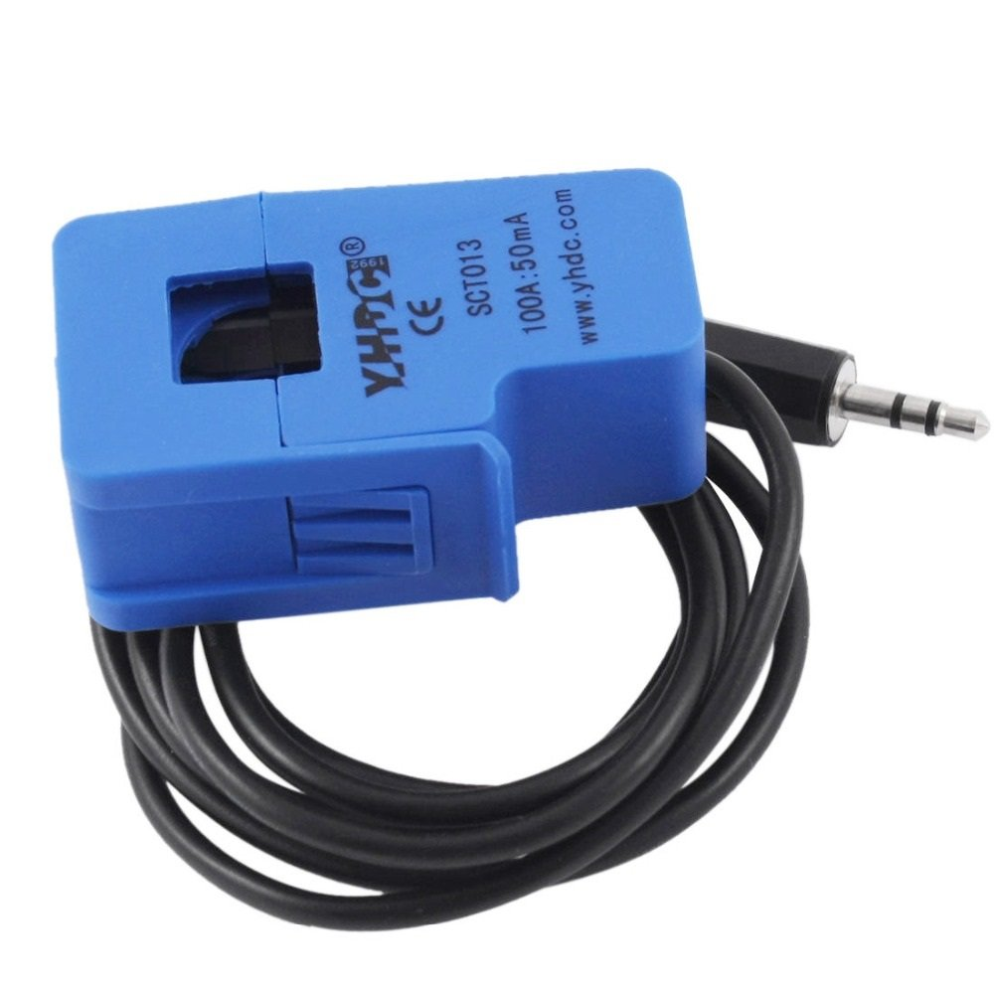
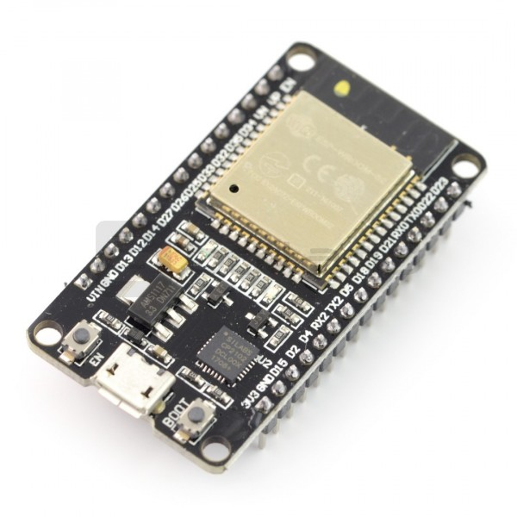
SCT-013-00 Current Sensor
ESP 32
SCT-013-00 Current Sensor

Slide 7
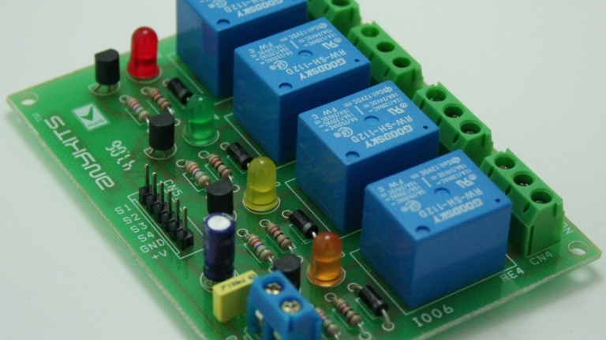
Relay Module

Slide 8
Parameters being monitored
Real time power, and Total Energy consumption
Session Data
Estimated bill (Total and session)
Load state

Slide 9
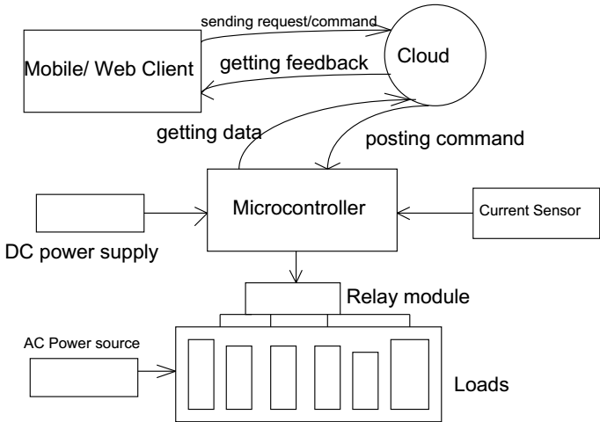
Block diagram

Slide 10
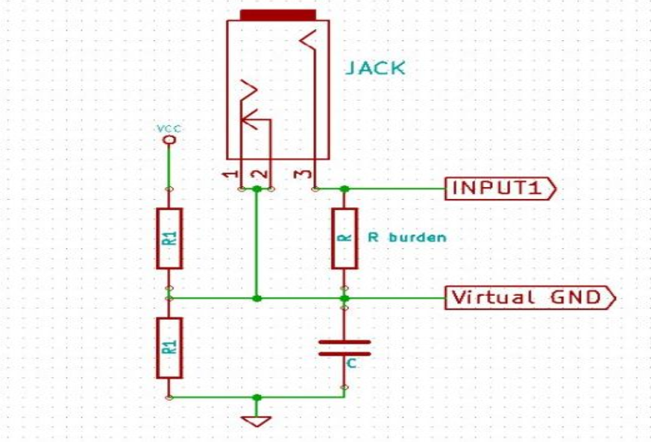
Schematic

Slide 11
Summary of components >
ESP 32 Microcontroller
Relay
SCT-013-000 Current Sensor
Internet gateway
Dashboard
Load devices
Power Source
MQTT Server
(message queuing telemetry transport)

Slide 12
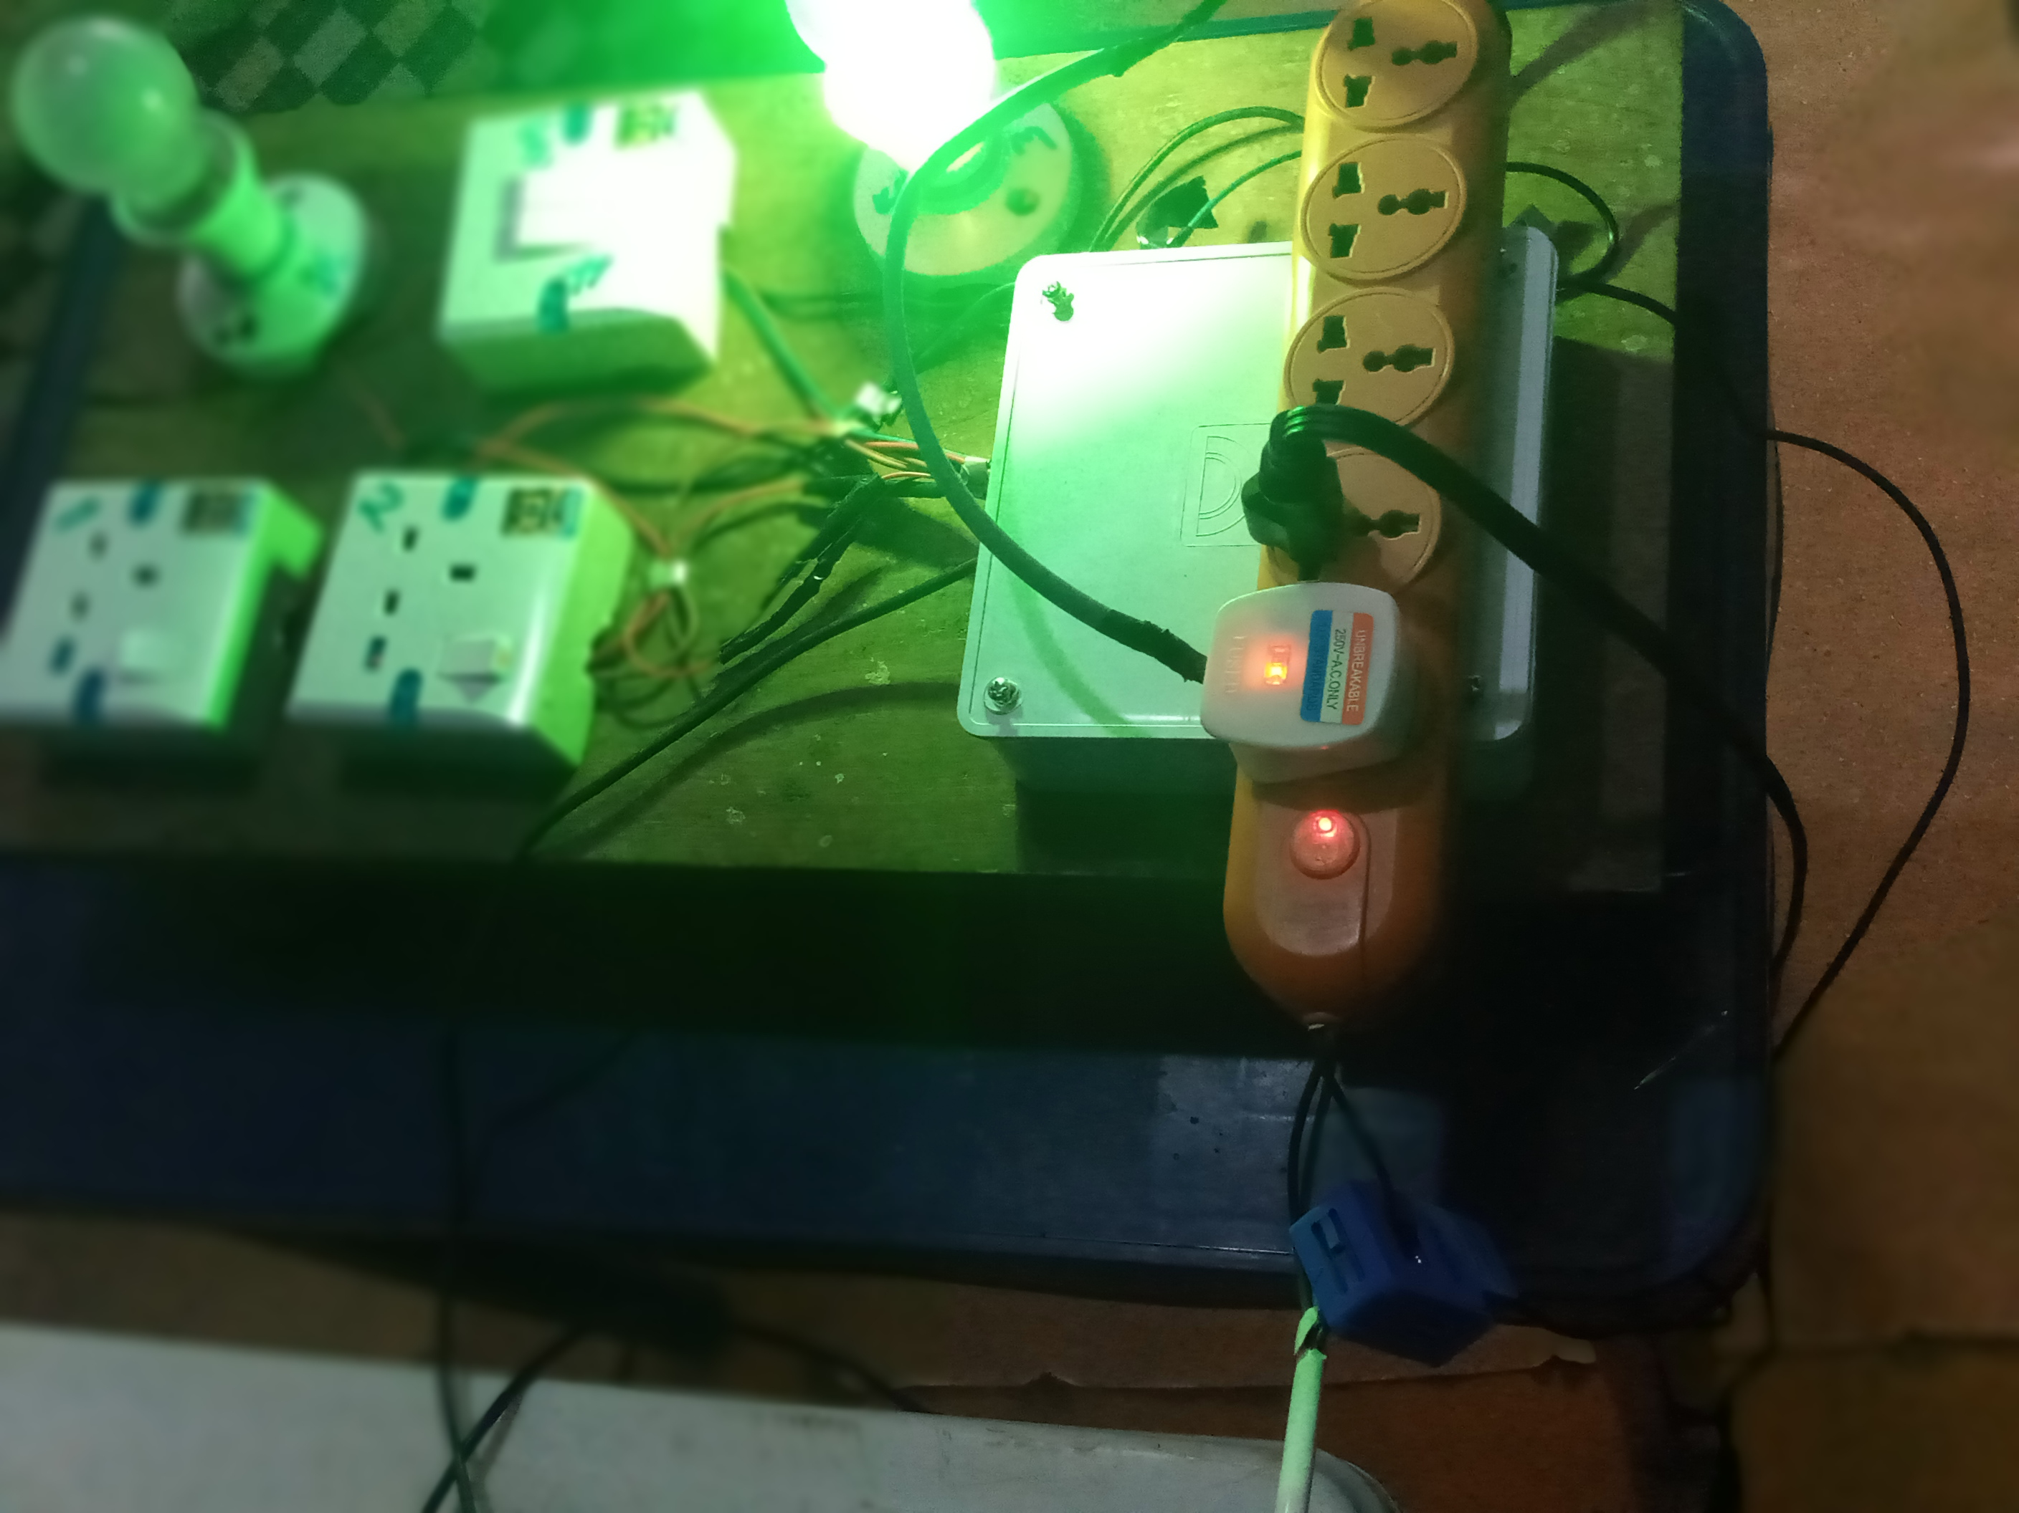
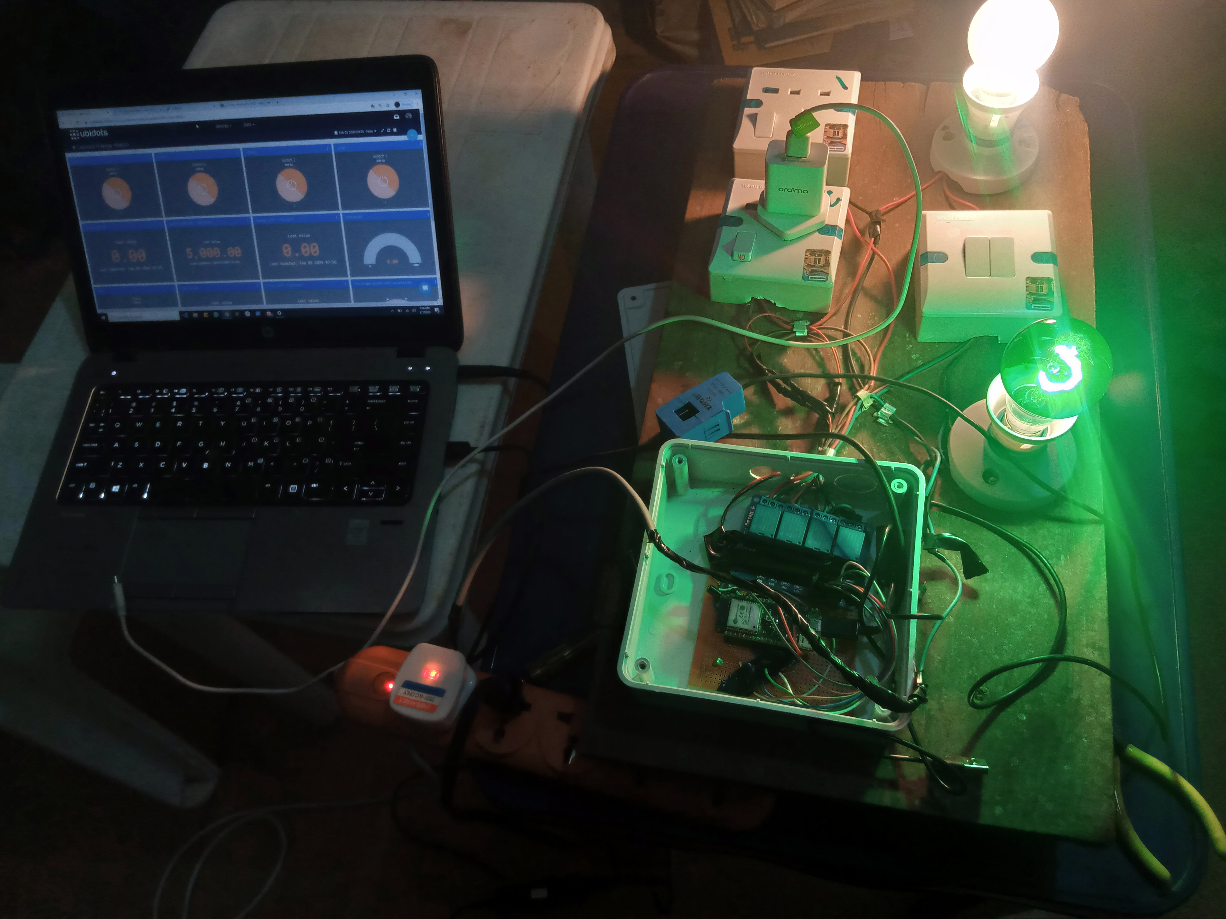
Result

Slide 13
Dashboard

Slide 14
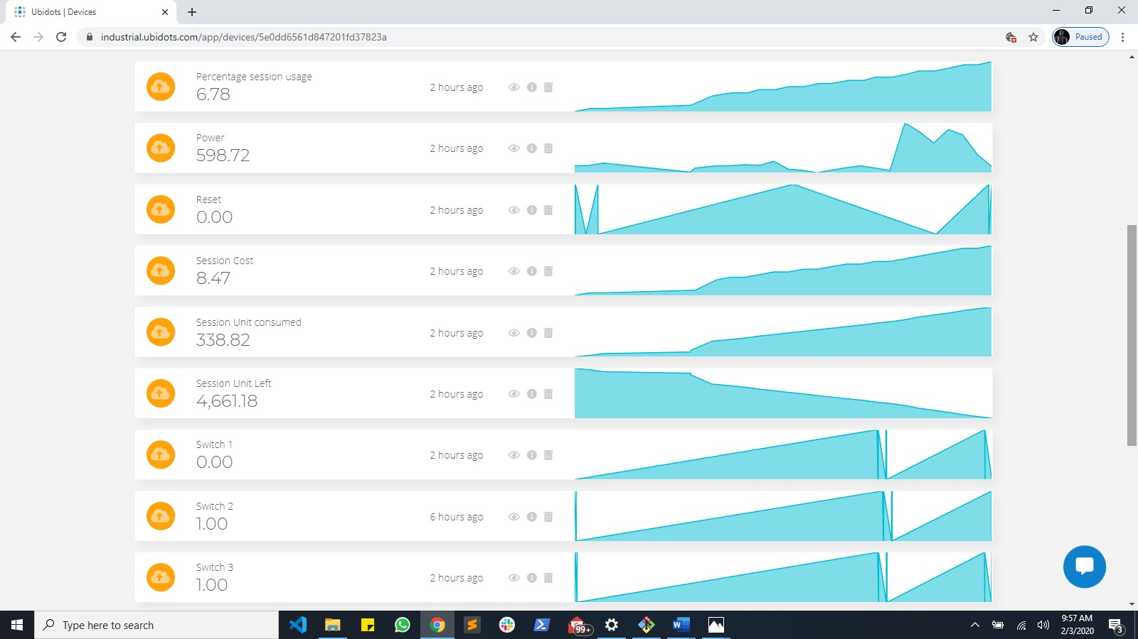
Data log and visualization

Slide 15
Application
Pay for what you use (e.g. Airbnb)
Shared houses (e.g. Rent houses)
Load control
Timed switching
Enhanced living condition (security inclusive)
Data
etc.

Slide 16
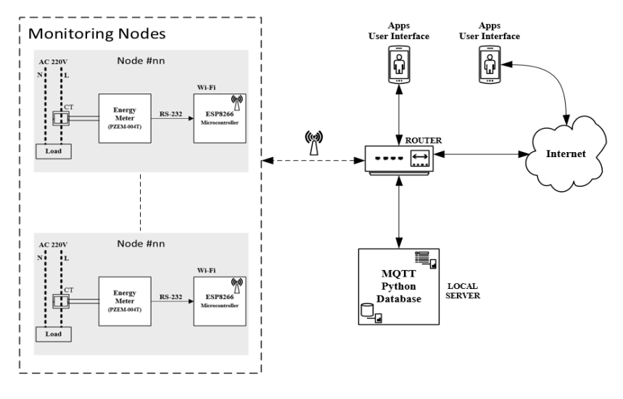
System overview of an IoT based energy monitoring system (Chooruang and Meekul, 2019)

Slide 17
Summary
Completed project consists of the hardware and a web dashboard
Current is read with SCT, calculated with ESP and displayed on dashboard
Commands are entered by user from the dashboard and sent to ESP, calculation values can also be set.
Power reading accuracy is not 100%
Communication highly depends on good network
Timed control
Thank You!

